Slide 1

Parking Finder Application

Slide 2

Presented by:
Hesham Elsaady 89431,
Belal Abdrabo 89411,
Solafa Salem 89409,
Esraa Adel 89517
Supervised by:
Dr. Maged Khafagy
TA. Ahmed Abdallah
TA. Shereen Youssef

Slide 3

Parking Finder Application
Team No: 70

Slide 4

Agenda
1
Introduction
Possible Beneficiaries
Motivation
2
3
Objectives
5
SDG’s Goal
6
Related Works
4
Problem Definition
Proposed System
System Architecture
7
8
9
Methodologies & Algorithms
System Requirements
10
11
SW/HW tools
12
Results & Outcomes
System Validation
13
System Analysis
14
15
Time Plan
17
Conclusion
References
16
18

Slide 5
1
Introduction

Slide 6
Introduction
Nowadays the world is getting bigger and It is thought the number of drivers is getting bigger on a daily at most people already own at least one car so the number of drivers is getting bigger on a daily and more people are having an issue that they cannot find a place to park their car easily and it takes them a lot of time therefore our target is to try to improve the previous issue. Our app allows user to compare spots, pre-book for parking, repaid and give his feedback as his opinion matters to us.

Slide 7
2
Possible Beneficiaries

Slide 8
Possible Beneficiaries
1-Commuters: People who drive to any destinations benefit from a parking finder by locating available parking spaces and avoid wasting time searching for parking.
2-City dwellers: Residents in busy cities often struggle to find parking spaces near their homes.
3-Tourists: When visiting a new city or town, tourists often face the challenge of finding parking near popular attractions. We guide them during their visit.
4-Event attendees: finding parking near event venues can be a hassle. A parking finder can help event attendees locate parking options and plan accordingly, enhancing the overall event experience.
5-Business owners: guide their customers to available parking spaces nearby, making it easier for visitors to access their establishment.

Slide 9

3
Motivation

Slide 10
Motivation
Having a car can be convenient, but finding a parking spot can be a pain in the neck, for both the driver and the society so our aim to help the drivers to find areas where parking is available in that area and find vacant parking spaces immediately around their destination.

Slide 11

4
Objectives

Slide 12
Objectives
As it raised our attention to the problem of the unorganized process of parking in the streets and the difficulty to find all garages in specific areas. It became our objective to solve this problem by using the advanced technology of our generation so they can be directed to the nearest parking easily with the needing to pre-pay for them.

Slide 13
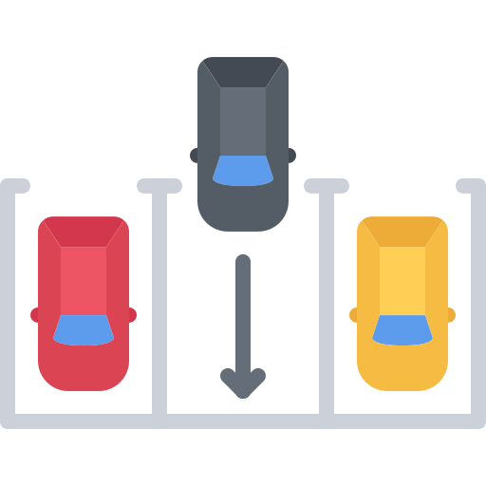
5
SDG’s Goal

Slide 14
SDG’s Goal
The SDG's goal of parking finder make cities more accessible and sustainable by providing efficient parking solutions which lead to increased revenue for cities and businesses, and a more positive experience for drivers.
-Industry, innovation and infrastructure: Innovation refers to our idea “parking finder application” , Infrastructure refers to the fundamental facilities and systems serving a country, ,including the services and facilities necessary for economy to function and our aim is to facilitate and improve the issue of parking

Slide 15
6
Related works

Slide 16
Related works
App/Feature | SpotHero | Best parking | Parknav | Parkmobile | Our app
Pre-booking | X | X |  |  | X
Feedback | X |  |  |  | X
Bookmark | X |  |  | X
Free trial |  |  | X
Not free | X | X | X | X | X
Cancel reservation | X
Scan code |  |  |  |  | X

Slide 17
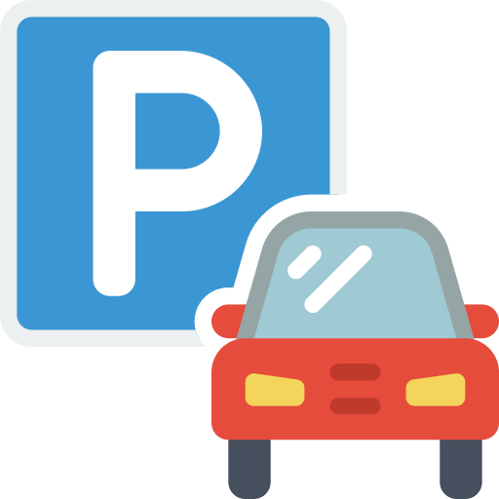
7
Problem Definition

Slide 18
Problem definition
Our problem can be defined as the unorganized way of parking in Egypt. Drivers can waste much time trying to find a vacant spot in the street or nearby garage to park their cars. Such as searching for a vacant spot in a street especially if it's crowded it may take a long time, or searching for empty spot can take a long time too. Which may lead to the possibility of parking the car in an unauthorized or unsafe parking spot and result in even more crowded and unorganized streets.

Slide 19
8
Proposed System

Slide 20
Proposed System
The user enter his information.
User looks for parking spaces in the area that he wants and put the time and date.
User books a spot by entering his vehicle plate number.
Before the user reaches the parking lot, the app will guide him to the assigned parking space to park the vehicle.
The parking fee can be paid through the app itself by visa or fawry.

Slide 21
9
System Archeticture

Slide 22
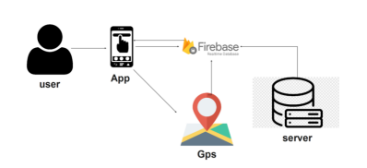
System Architecture

Slide 23
10
Methodologies & Algorithms

Slide 24
Algorithms
Firebase Authentication
Firebase Fire store
One-time passwords (OTP)
Methodologies
Agile Methodology
To verify E-mail and password.
It is a project management methodology purposely adopted for the development of sophisticated software.
Cloud real time database.
Authentication
It is the process of identifying users that request access to a system, network, or device. Access control often determines user identity according to credentials like username and password.
It’s an algorithm that provide a mechanism for logging on to a network or service using a unique password that can only be used once, as the name suggests
Encryption
It is a method that used to transform data into ciphertext

Slide 25
11
SW/HW tools

Slide 26
SW/HW tools
Software Tools:
Operating system:
Windows, Unix, Linux, IOS and Android.
Coding language:
Flutter, Dart.
Editor:
Android Studio, VS code.
Hardware Tools:
Computer, laptop:
With Ram minimum of 2 GB. With 20+ hard disk, SSD preferred With CPU Core i3 running 2.5GHz or higher
Mobile Phone:
Working with Android or IOS

Slide 27
12
System requirements

Slide 28
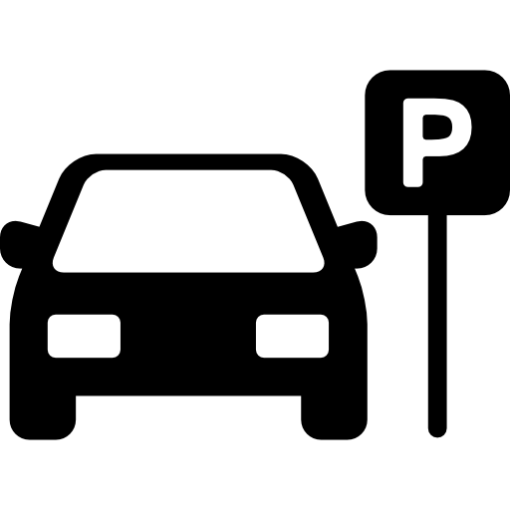
Functional Requirements FR
Registration and login.
Users can edit their info (username, email, phone number, password).
Request a location to park at.
Returned list of locations sent to user with estimated duration and price.
User can check his spot information, price and his timestamp from history.

Slide 29
Non-Functional Requirements NFR
Availability
Reliability
Scalability
Performance
Security
Usability
Extensibility

Slide 30
13
System analysis

Slide 31
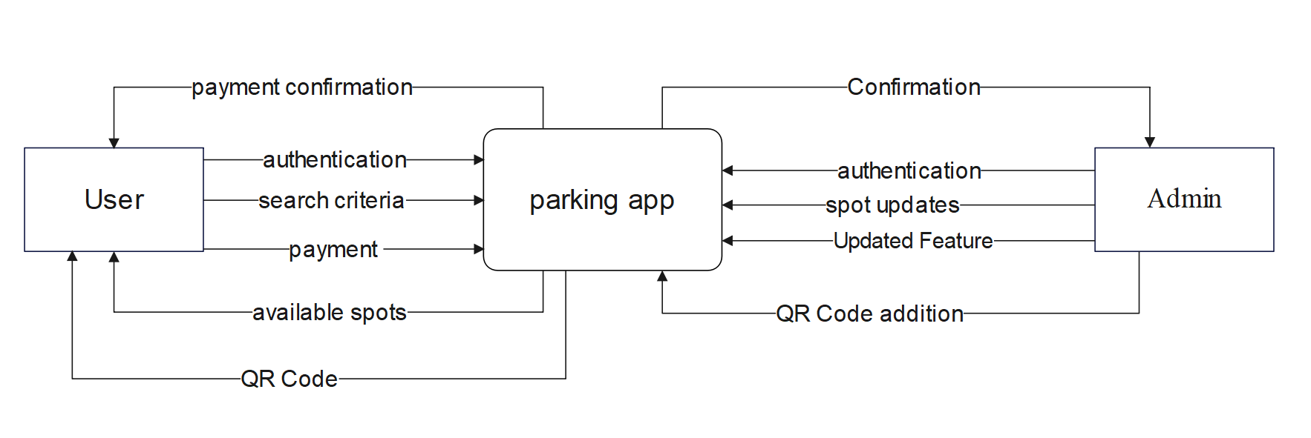
Context Diagram

Slide 32
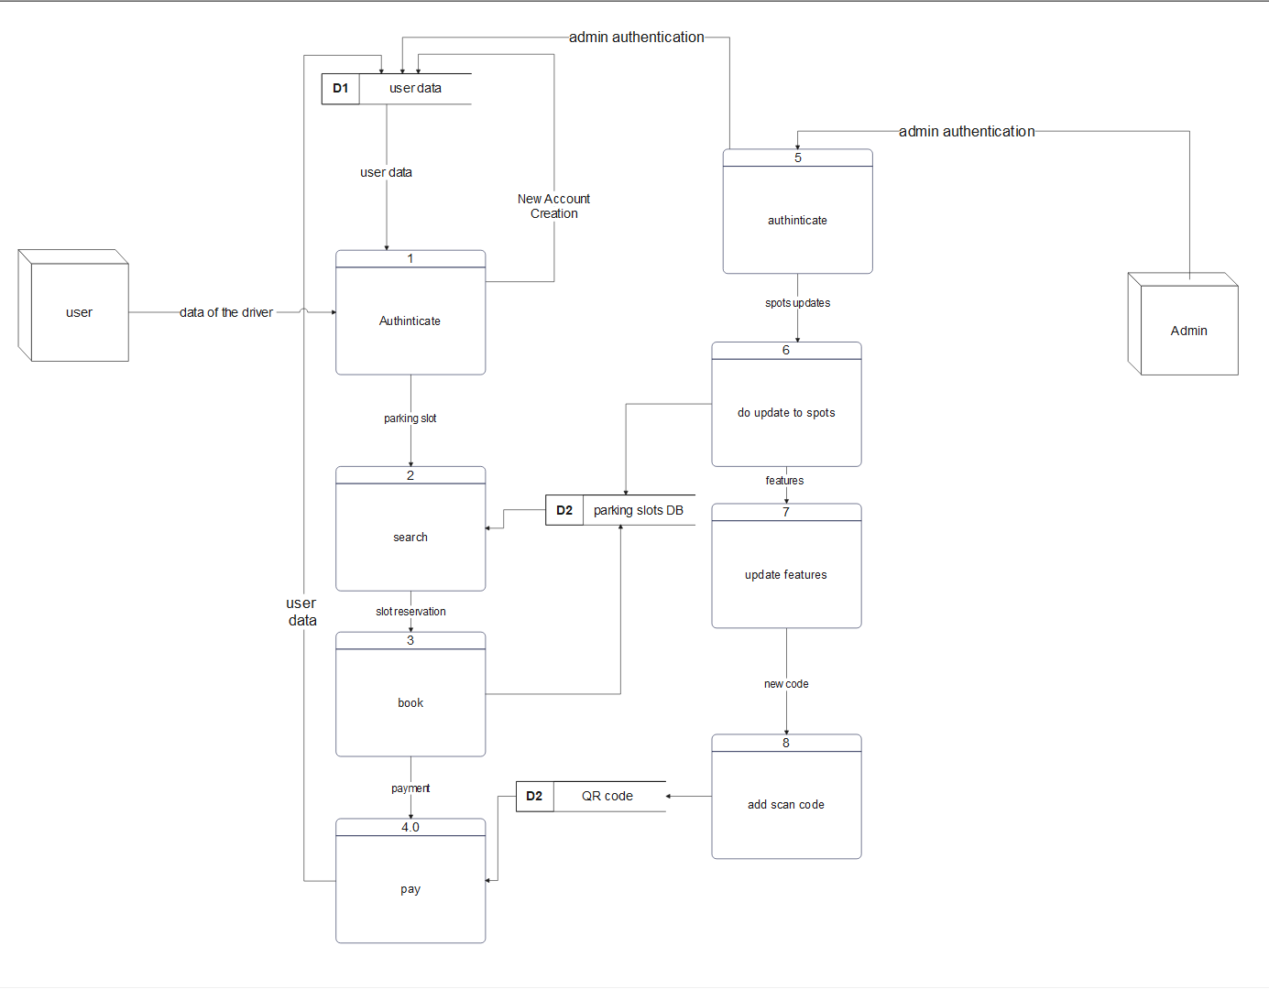
DFD (Level 0)

Slide 33
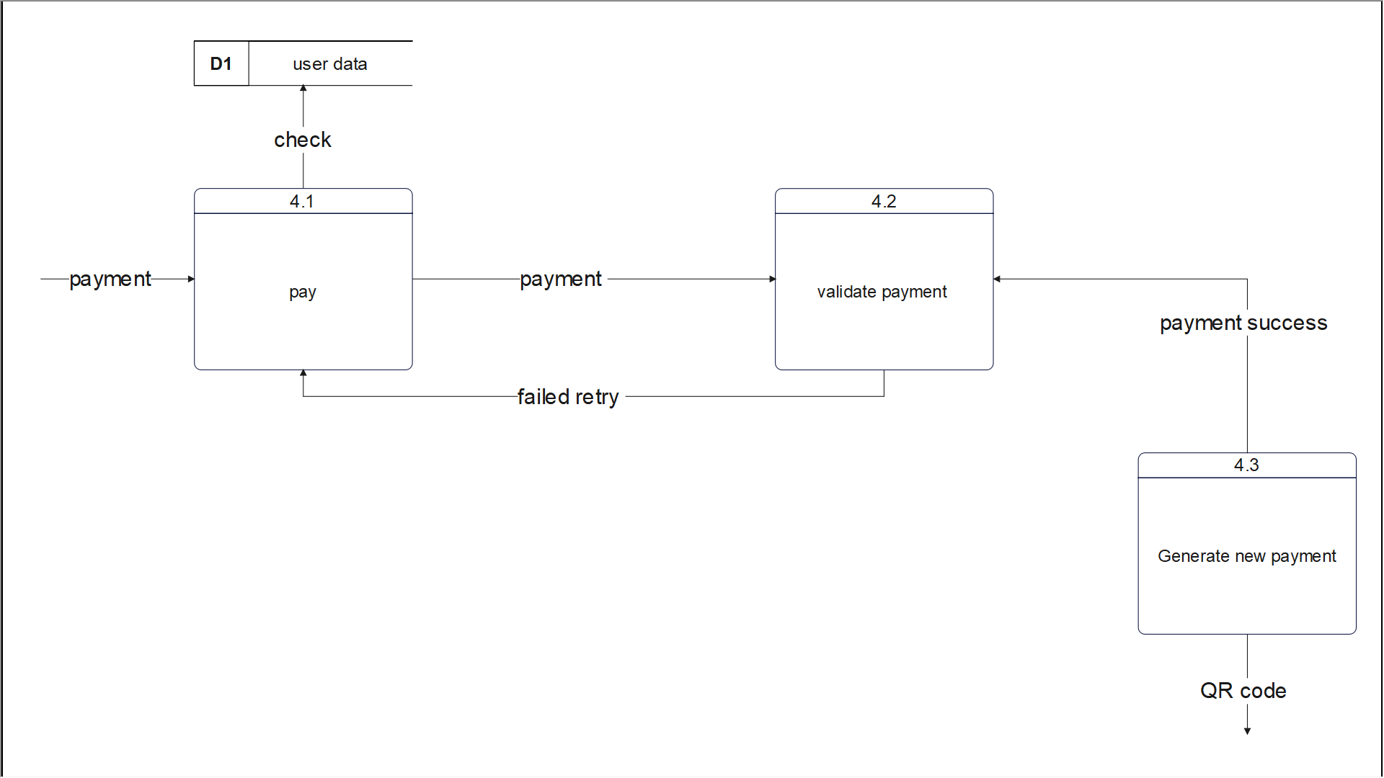
Child Diagram

Slide 34
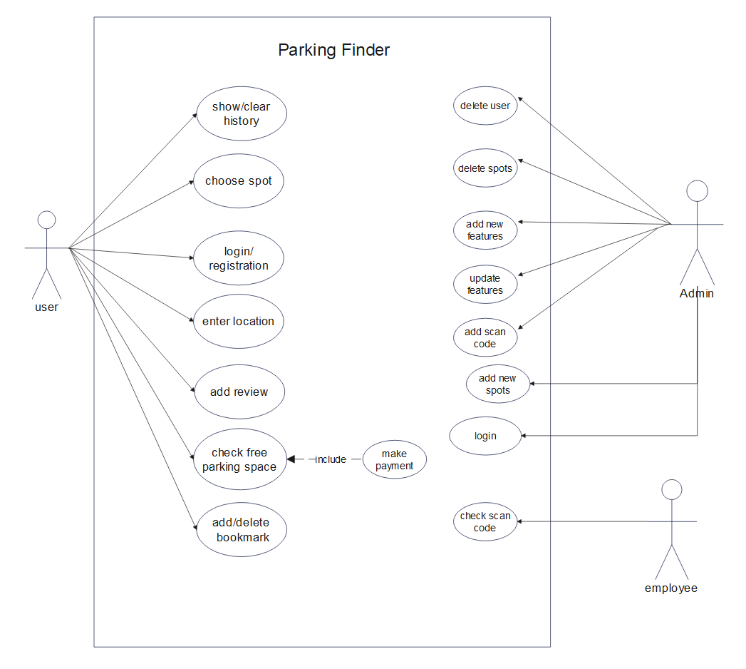
Use-case Diagram

Slide 35
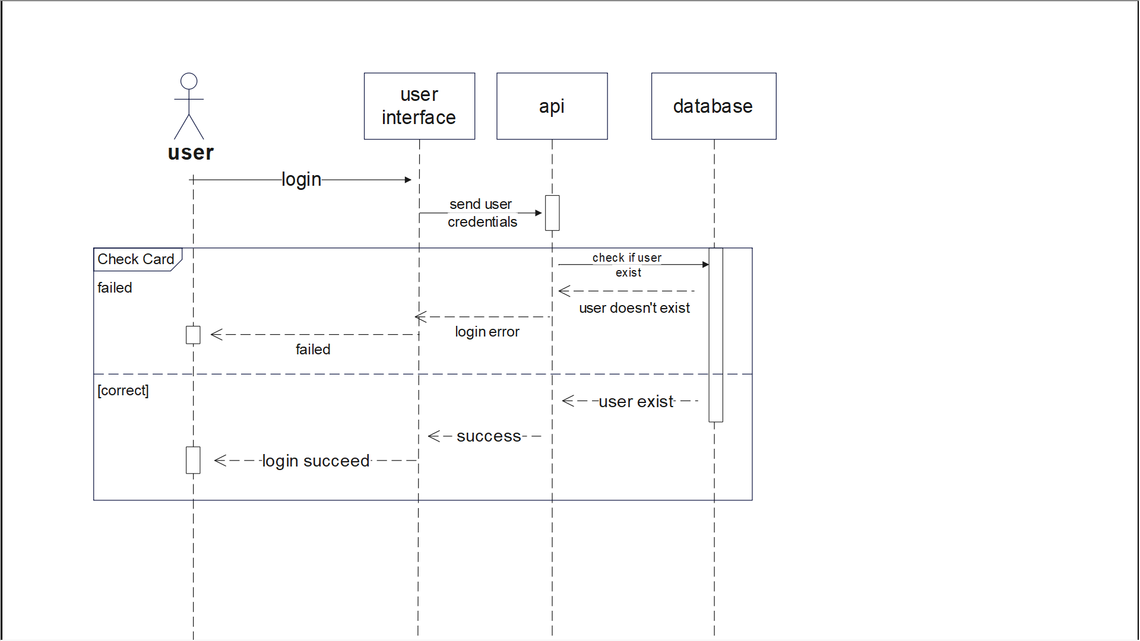
Sequence Diagram for Login (1/5)

Slide 36
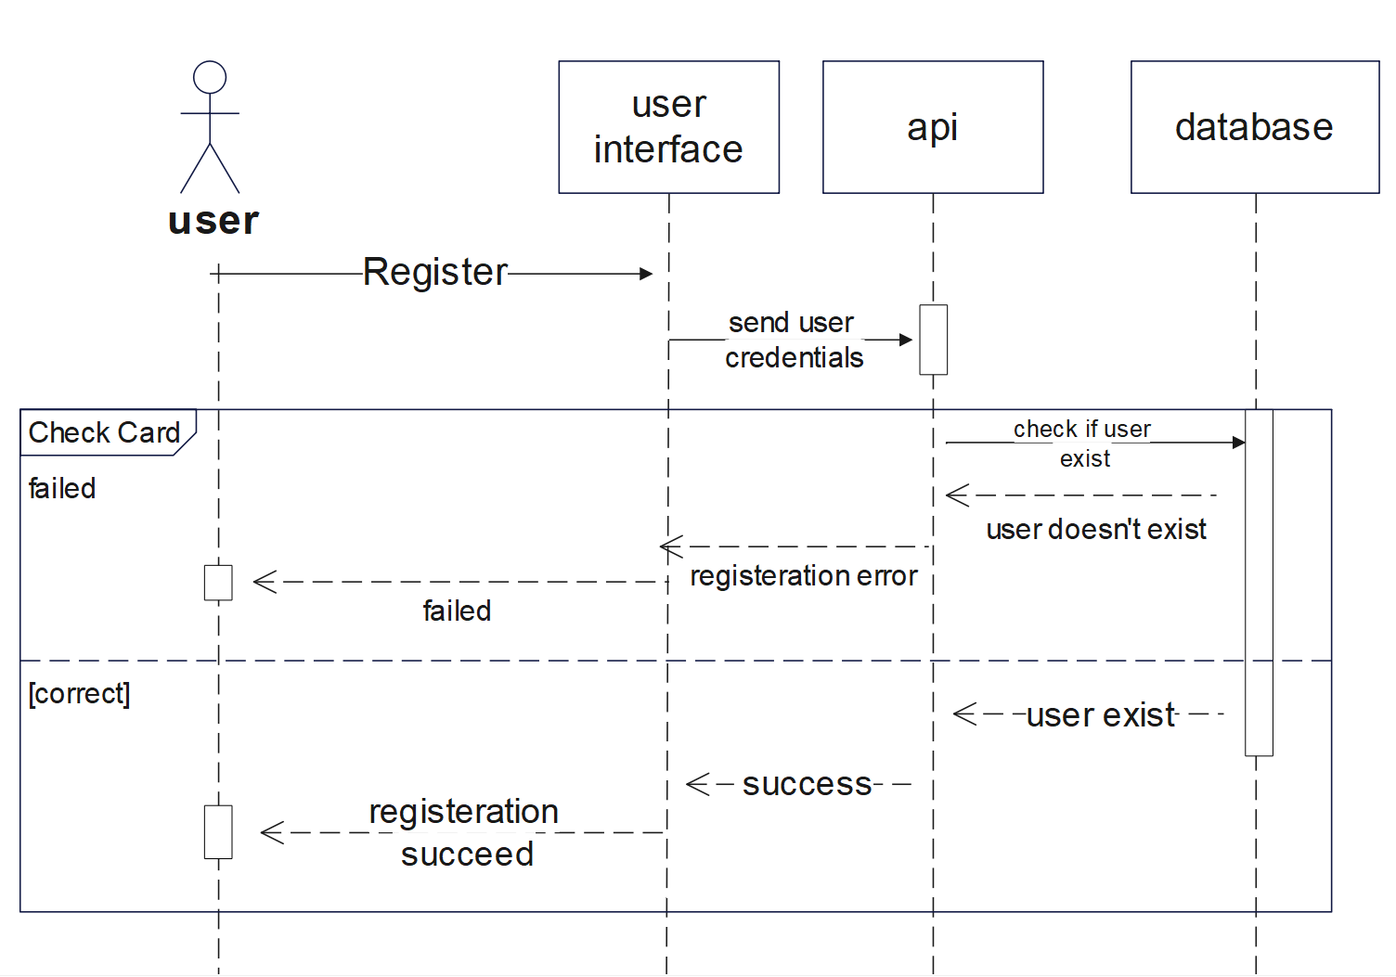
Sequence Diagram for Registration (2/5)

Slide 37
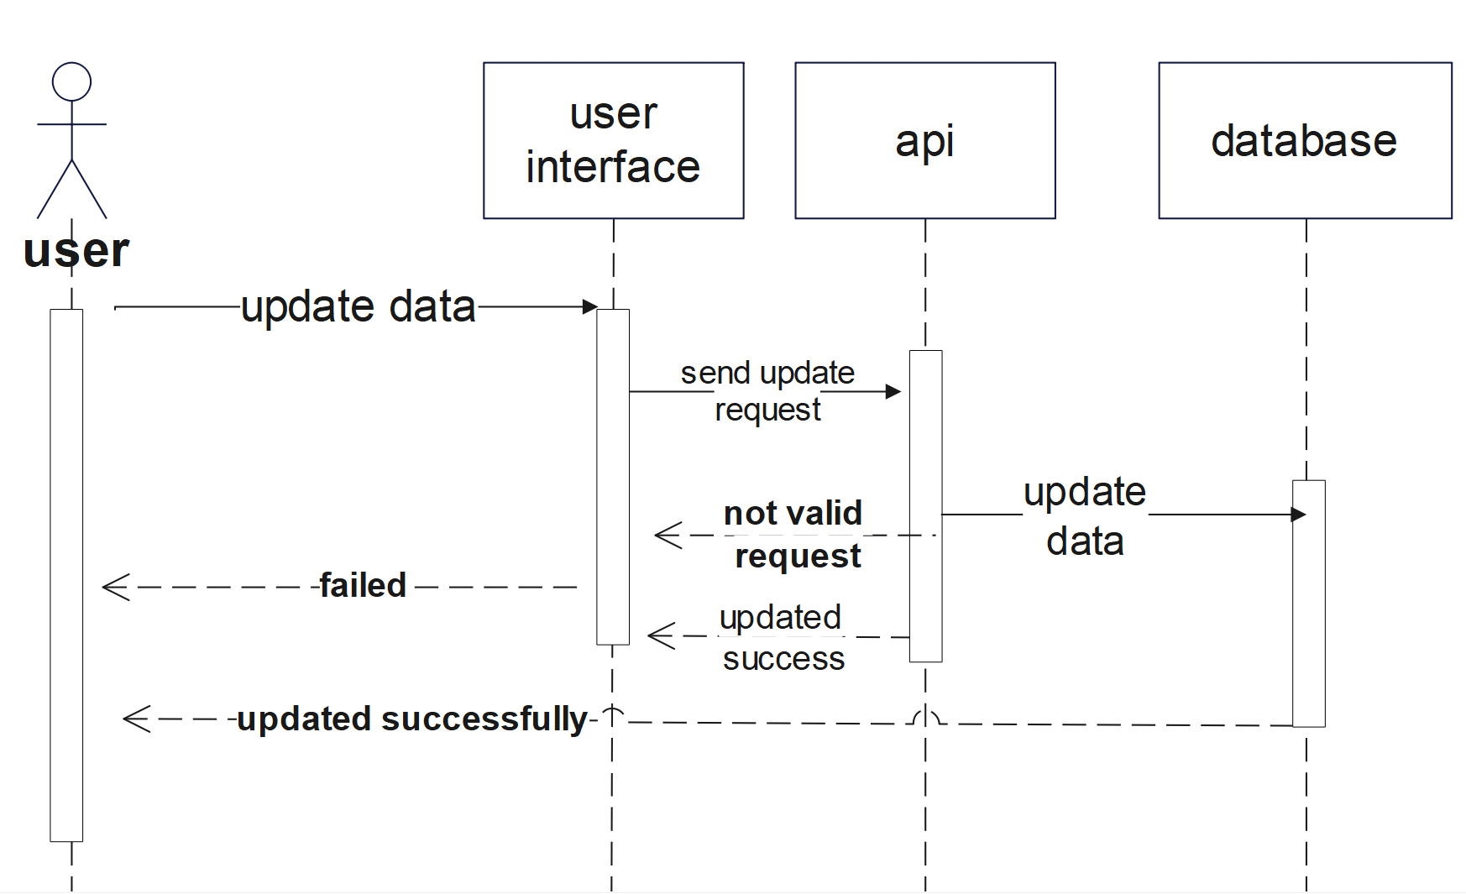
Sequence Diagram for Updating(3/5)

Slide 38
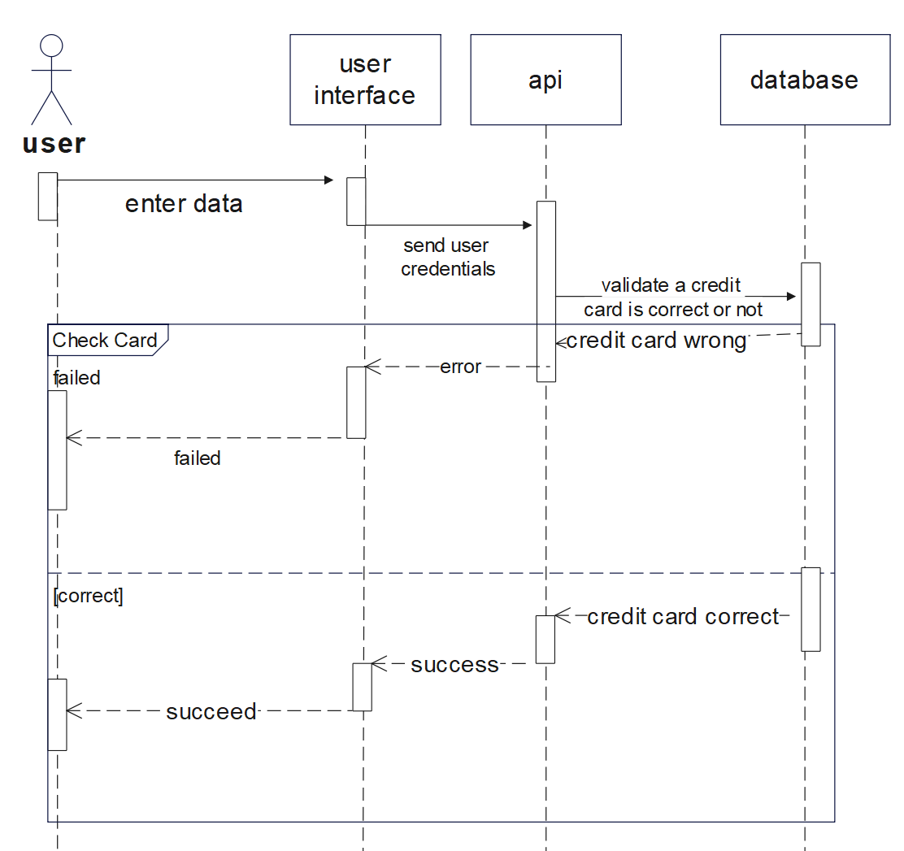
Sequence Diagram for Payment(4/5)

Slide 39
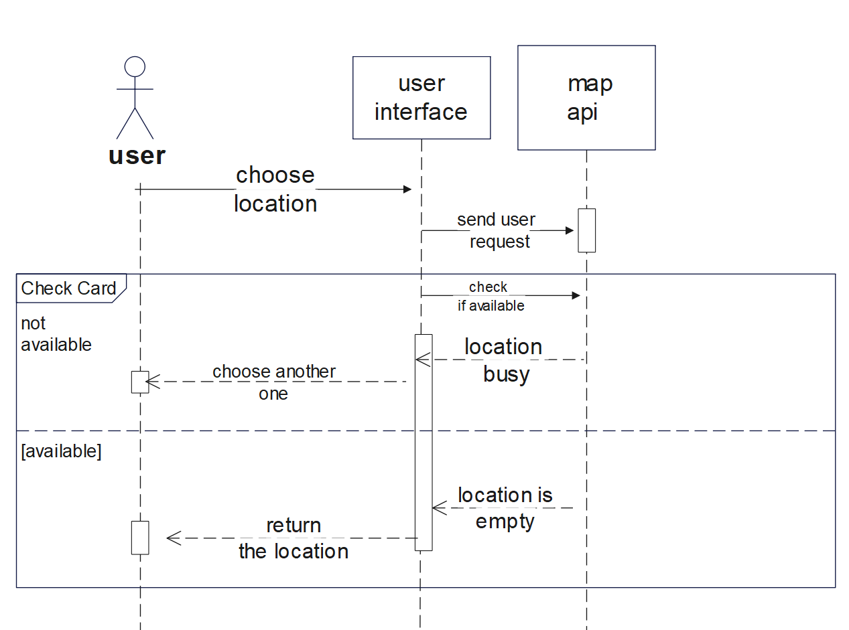
Sequence Diagram for Location(5/5)

Slide 40
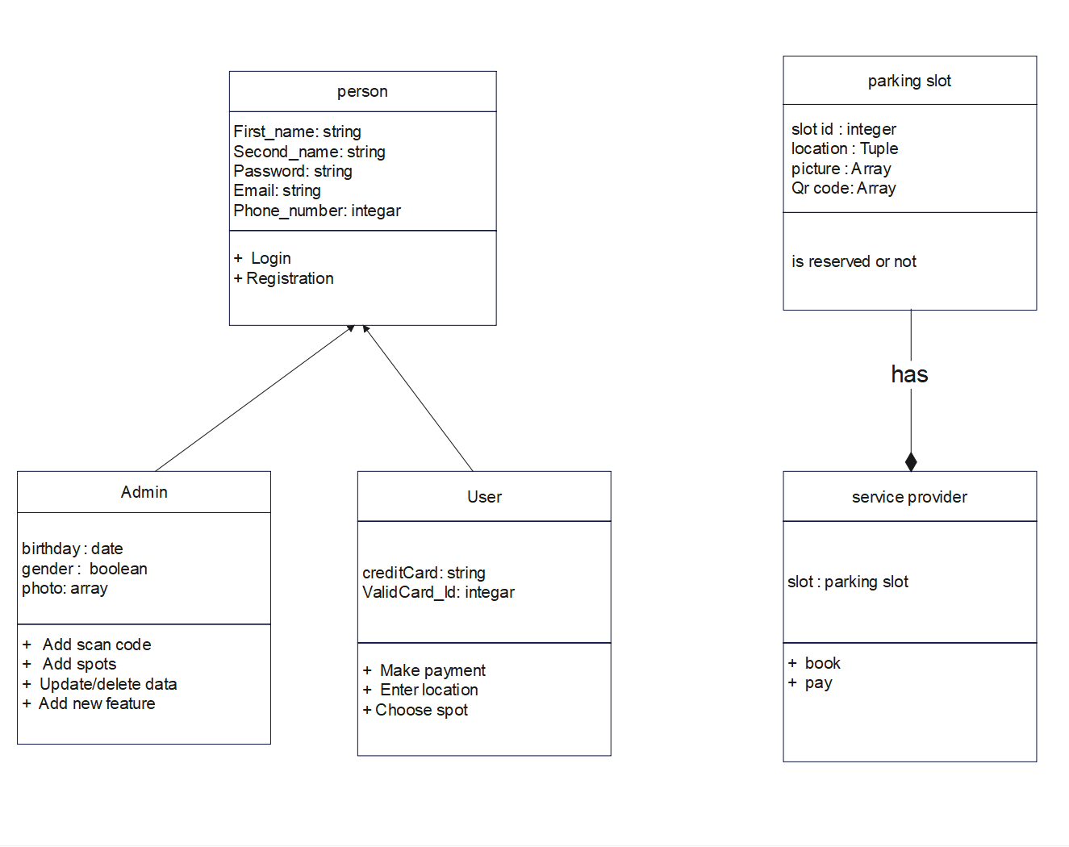
Class Diagram

Slide 41
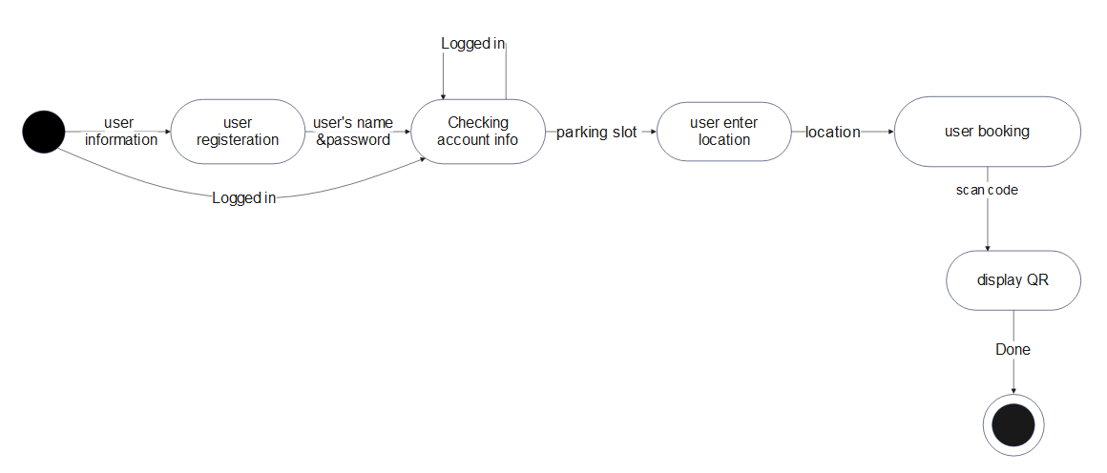
State-chart Diagram

Slide 42
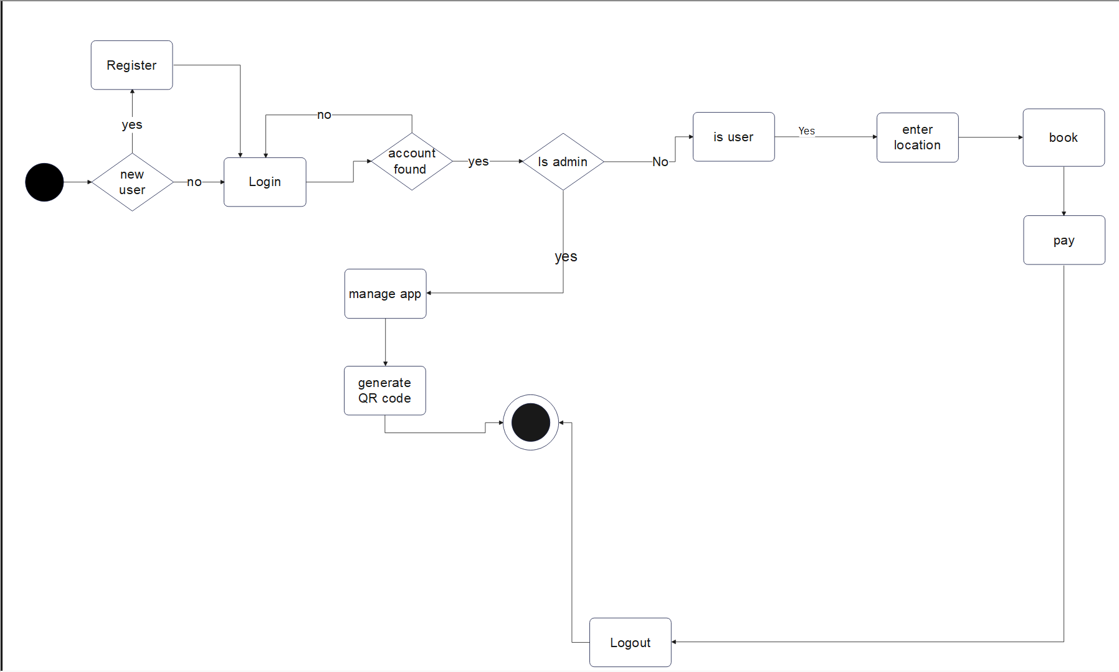
Activity Diagram

Slide 43
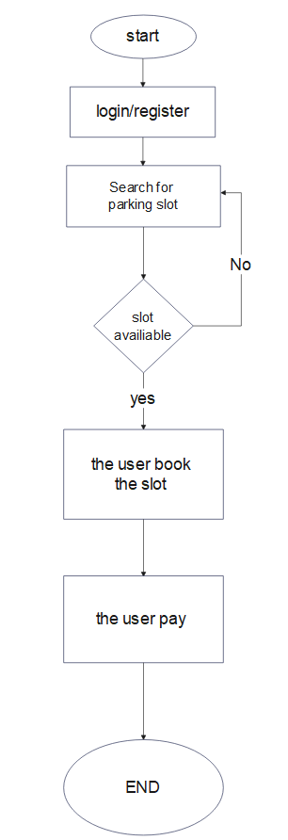
Process Flow Diagram (PFD)

Slide 44
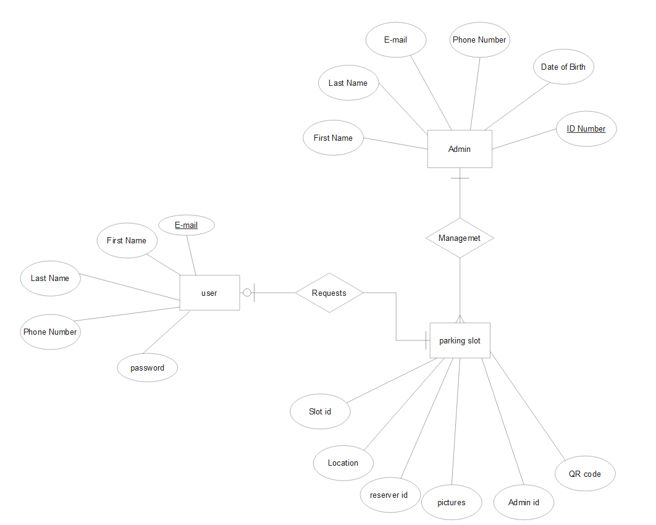
Entity Relationship Diagram (ERD)

Slide 45
14
Results & Outcomes

Slide 46
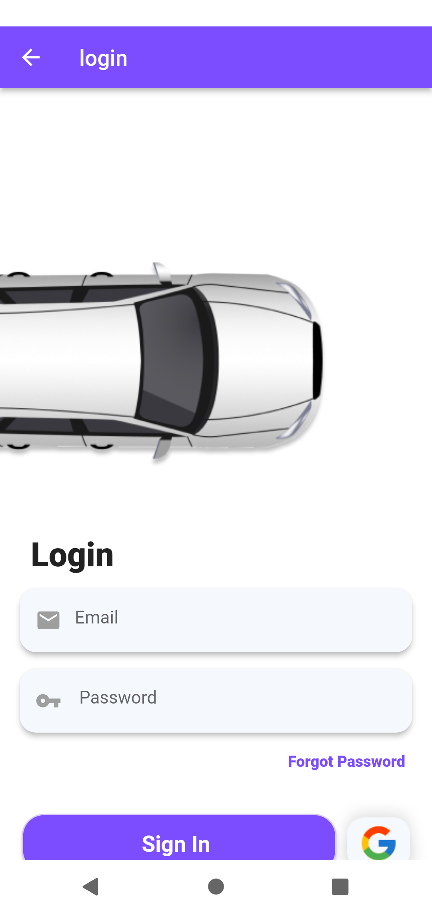
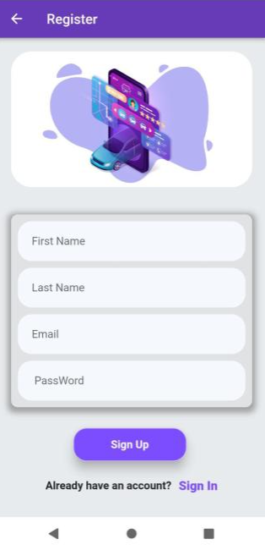
Login
Signup

Slide 47
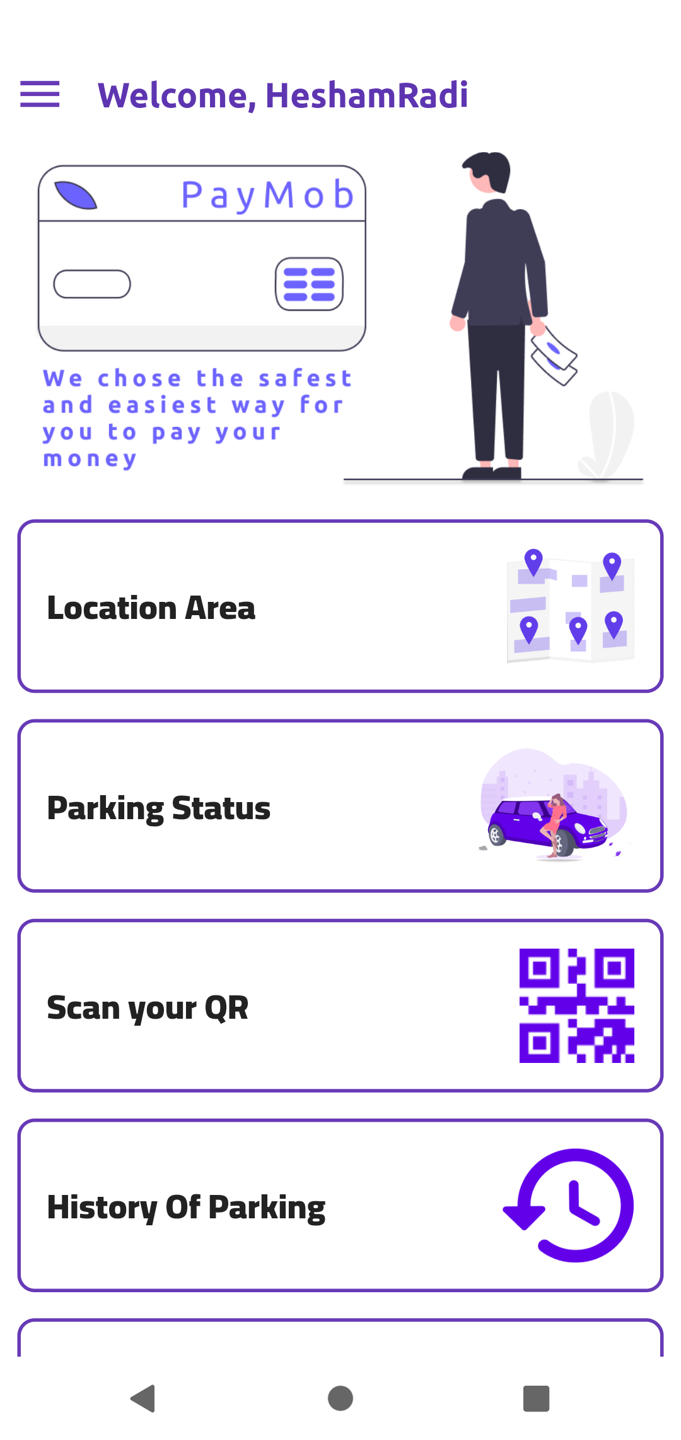
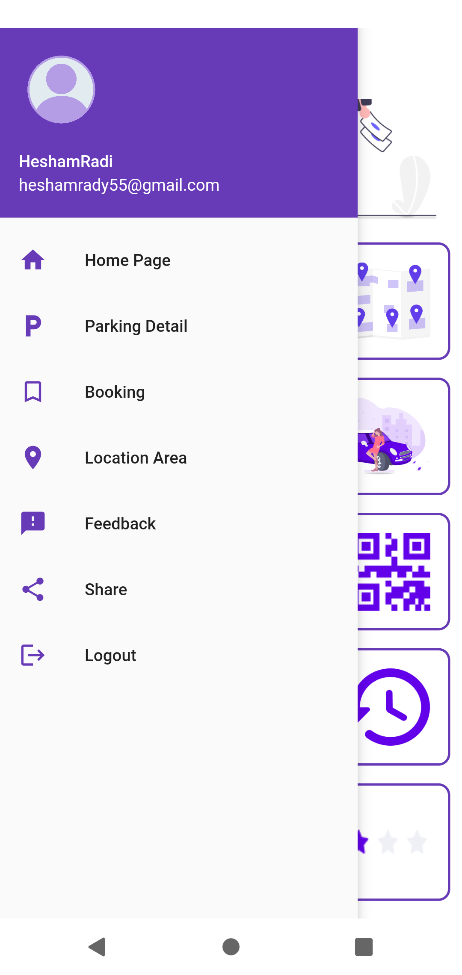

Home
Drawer
Gates

Slide 48
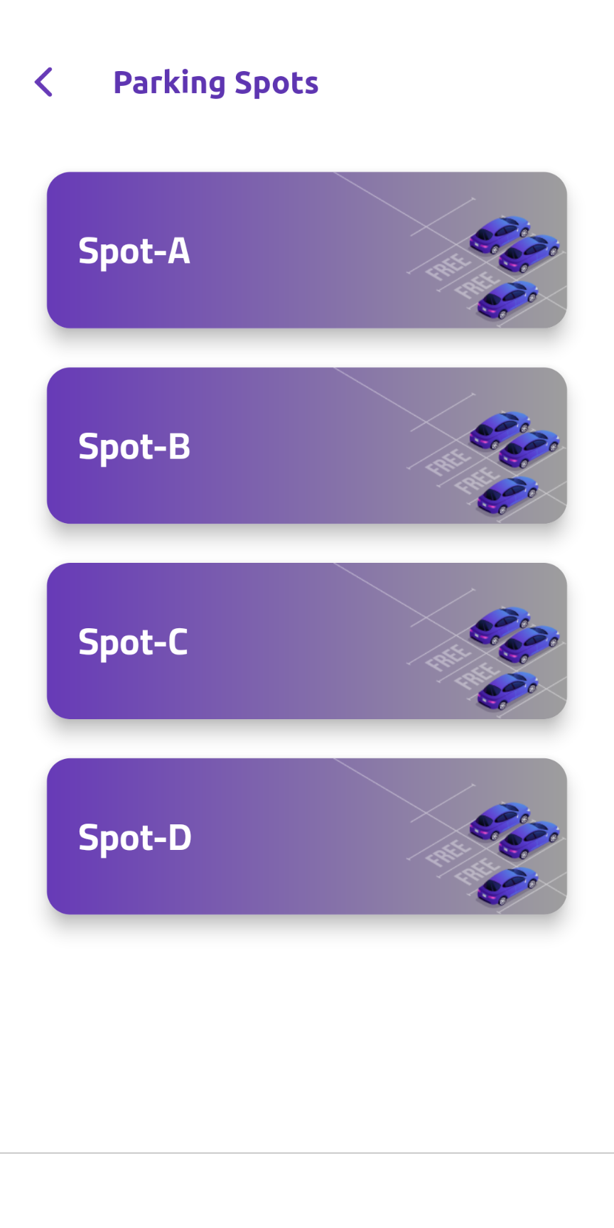
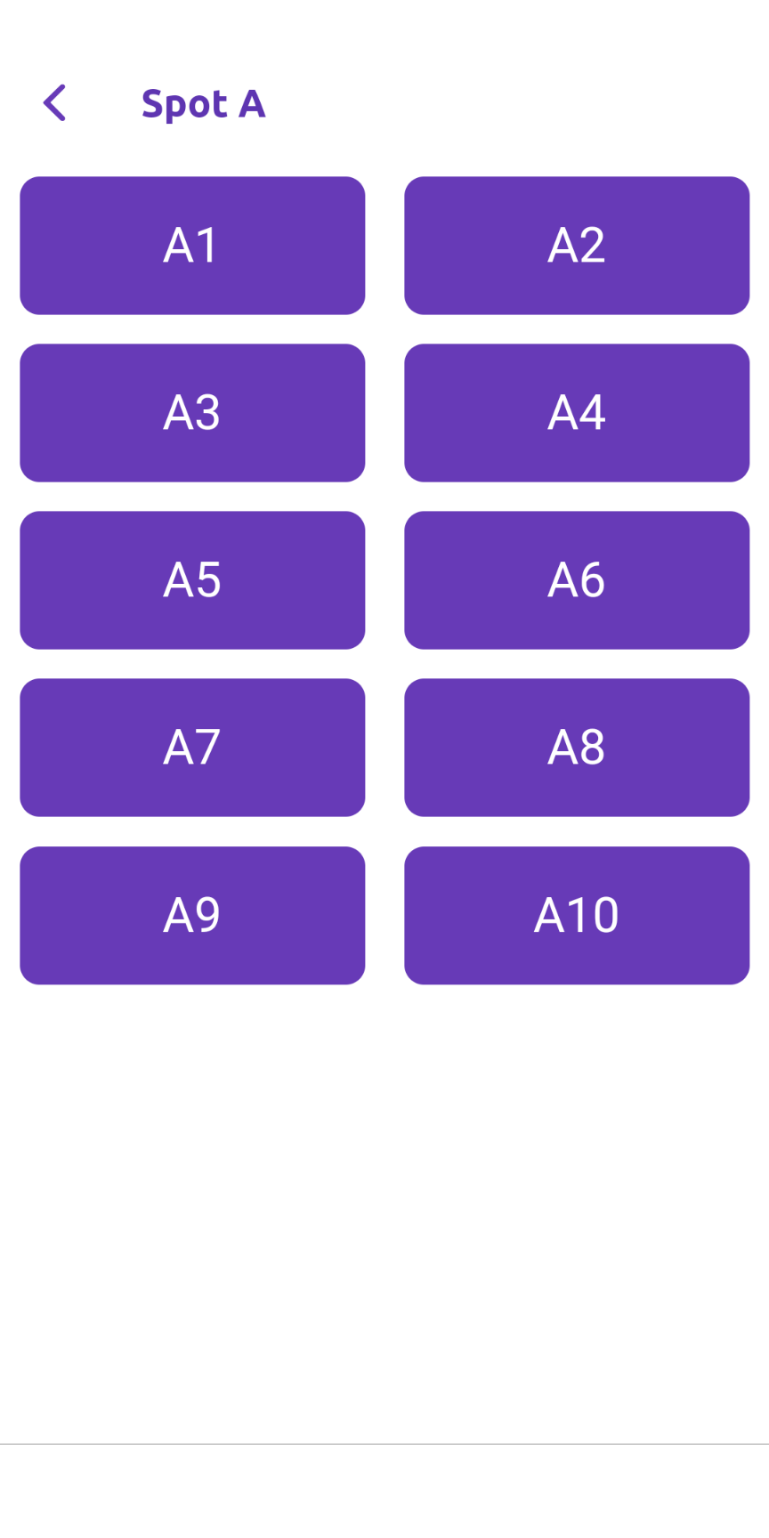
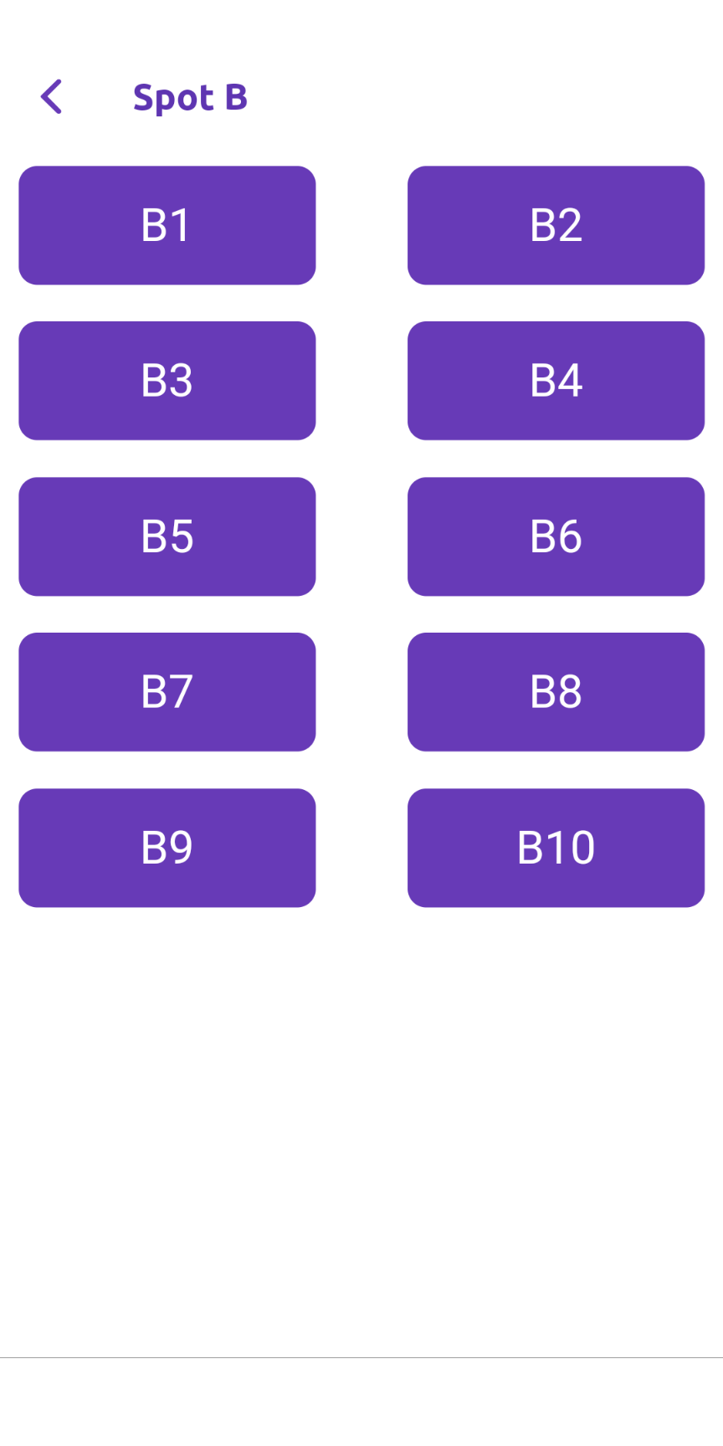
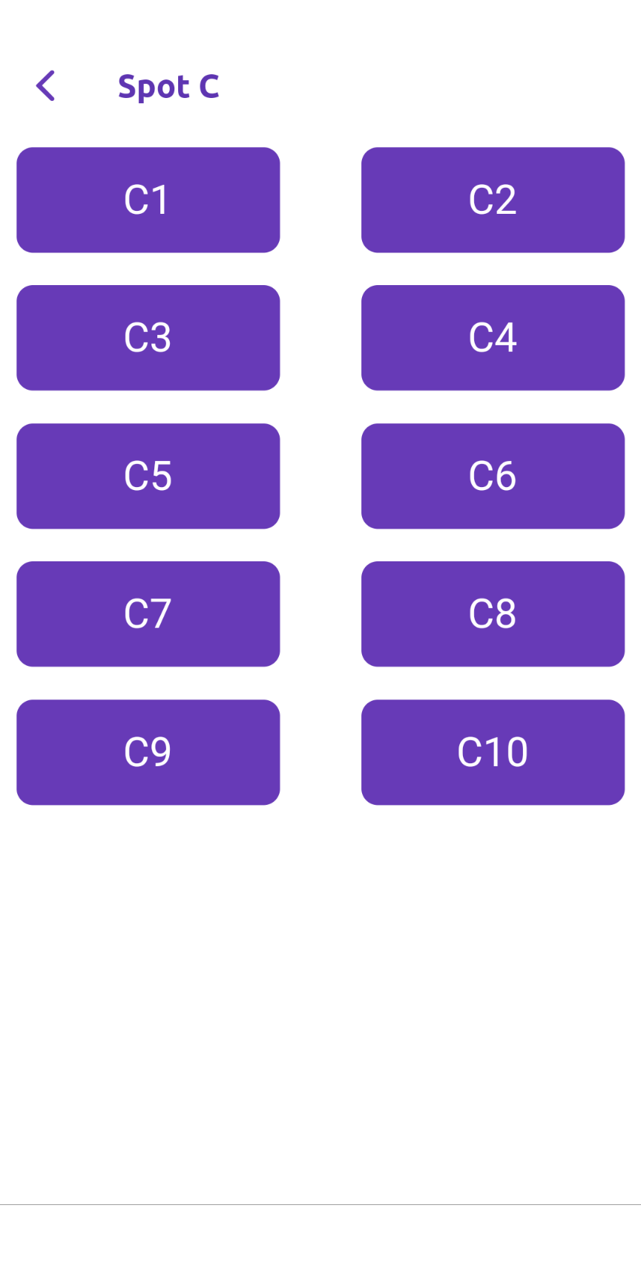
Parking spots

Slide 49
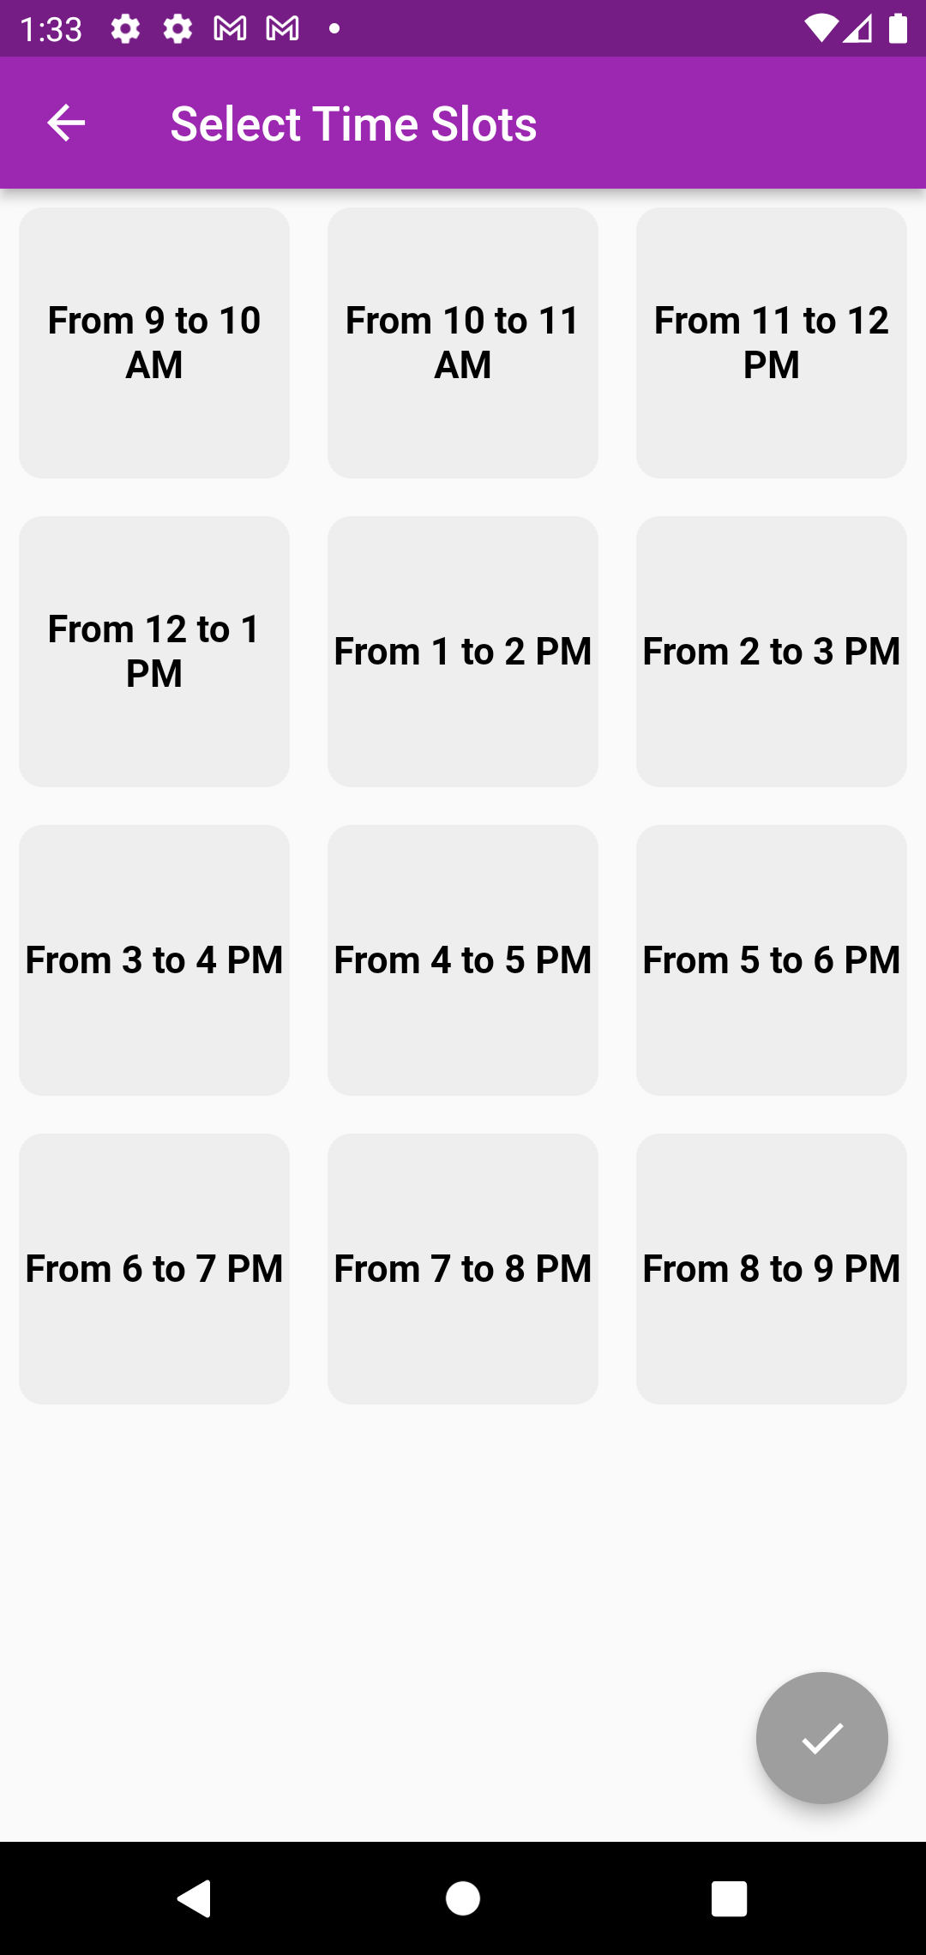
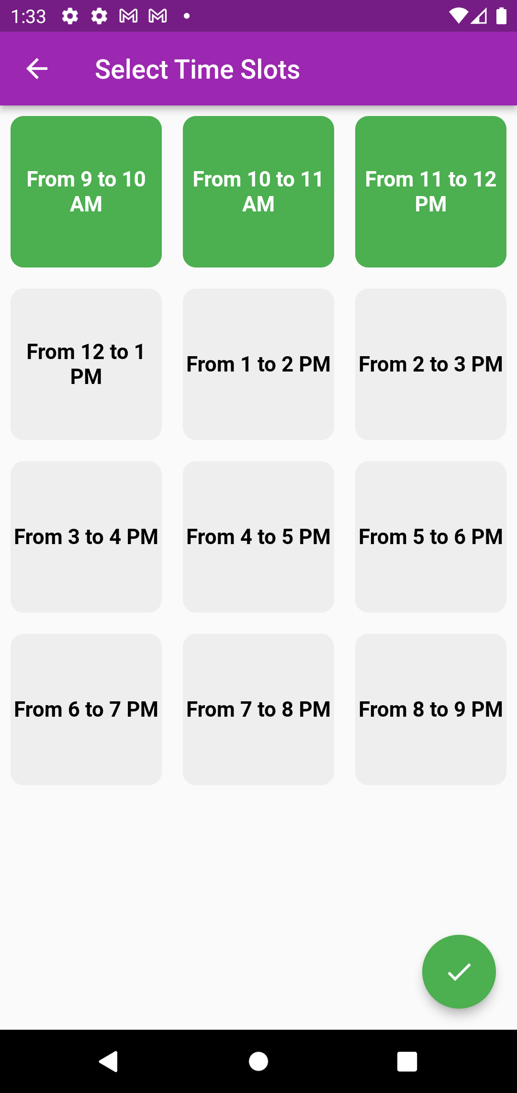
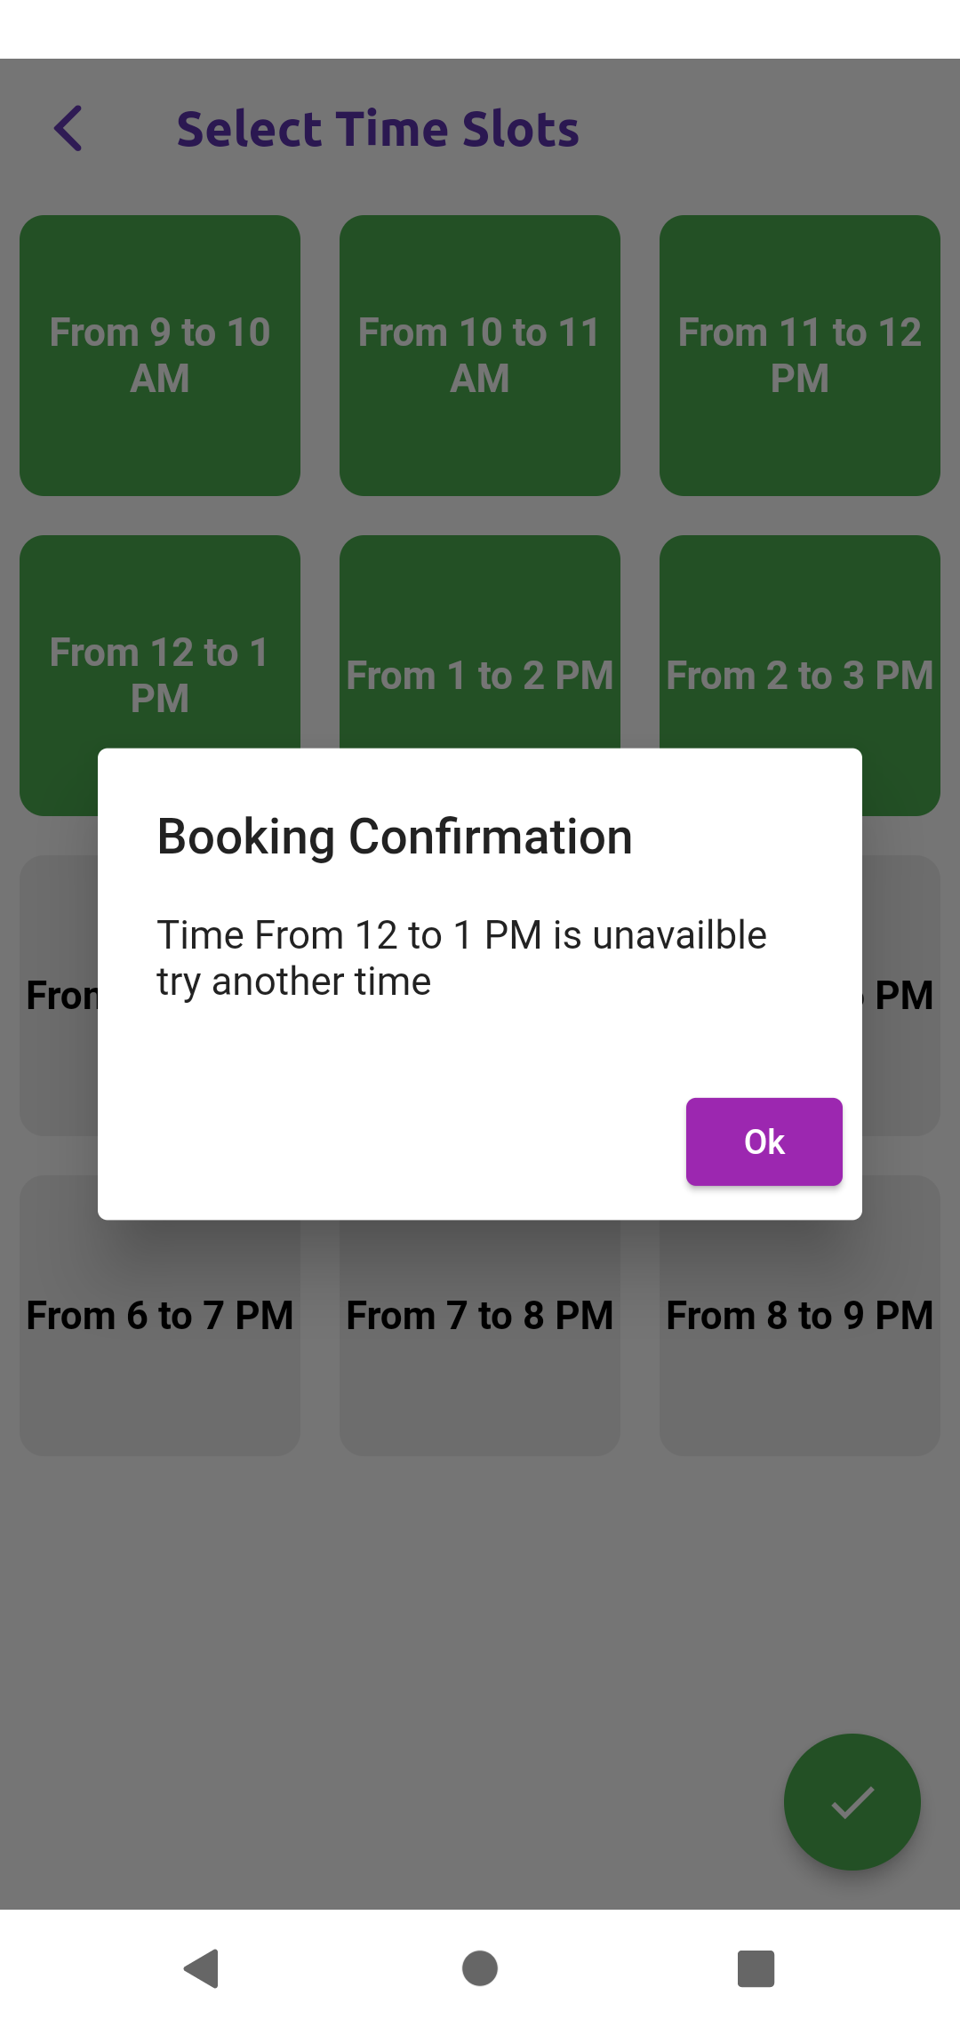
Choose time
Unavailable time

Slide 50
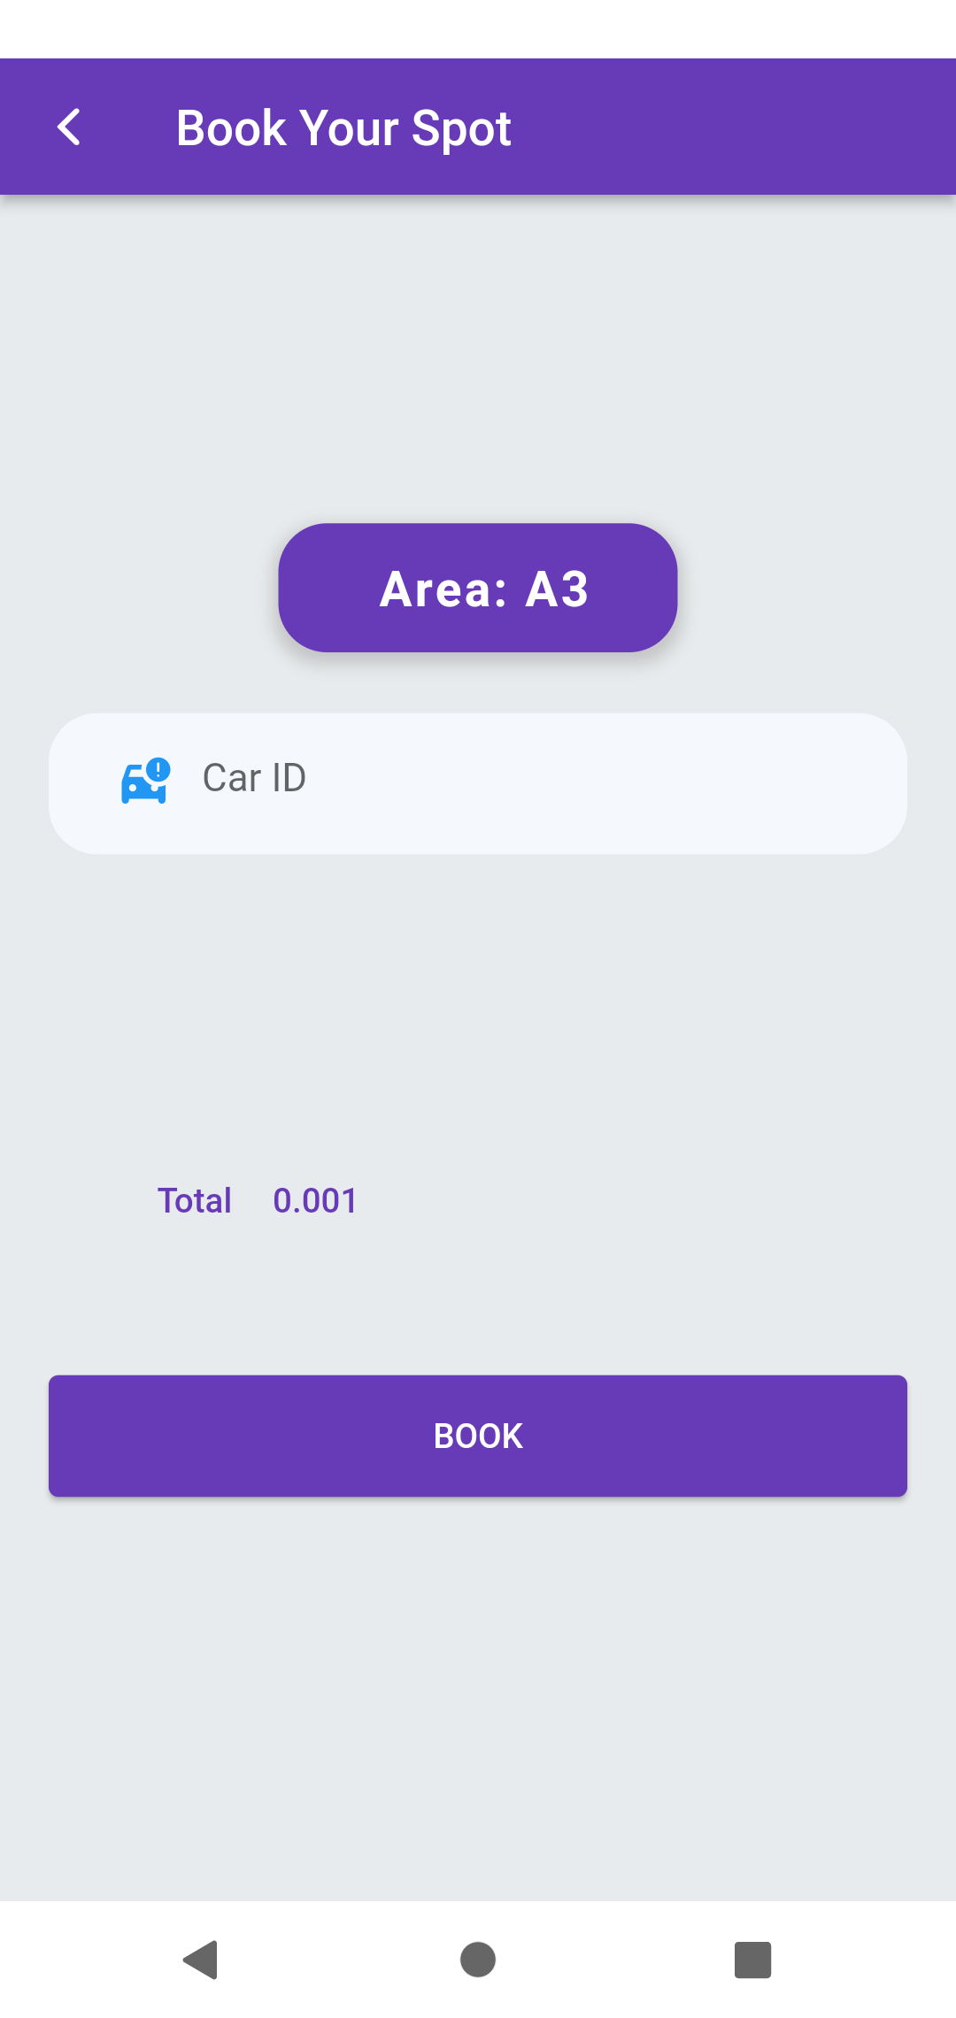
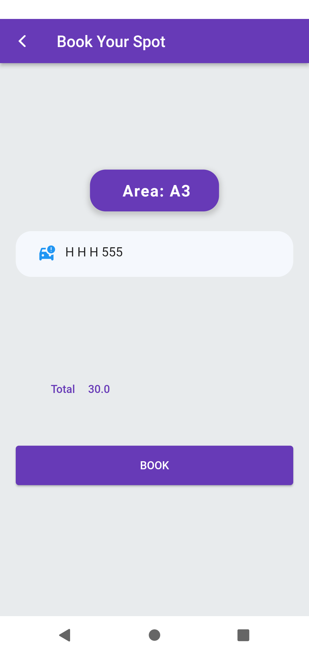
Booking

Slide 51
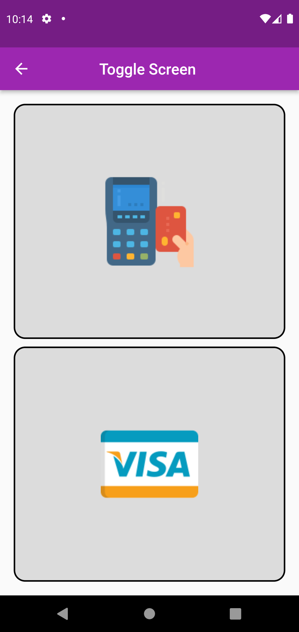
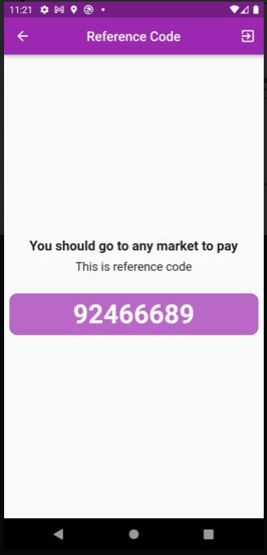
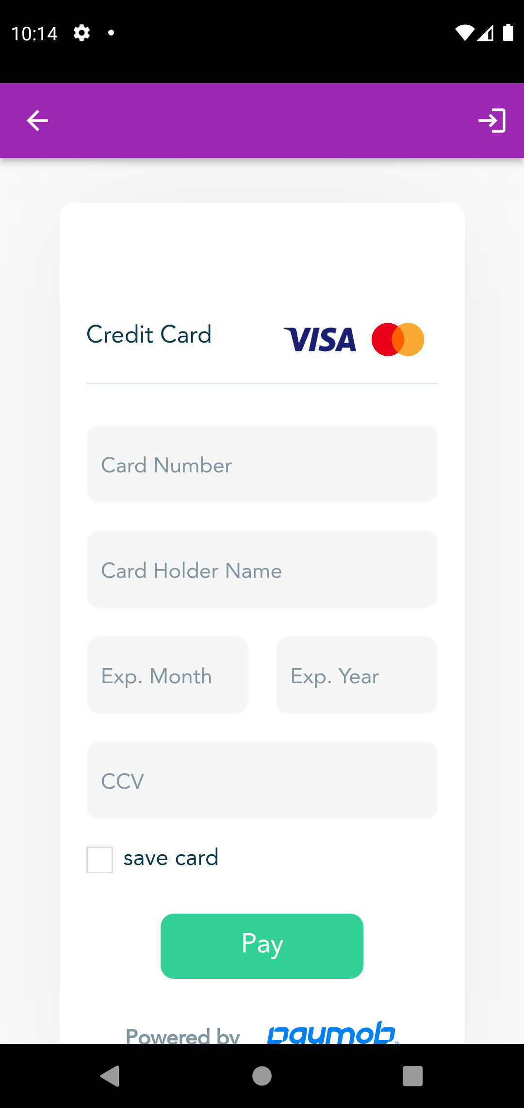
Payment
Fawry
Visa

Slide 52
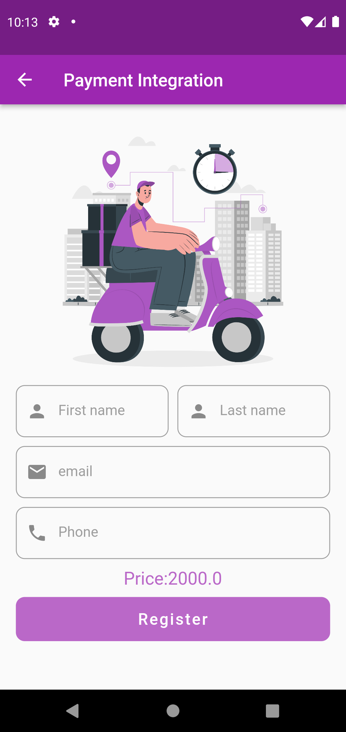
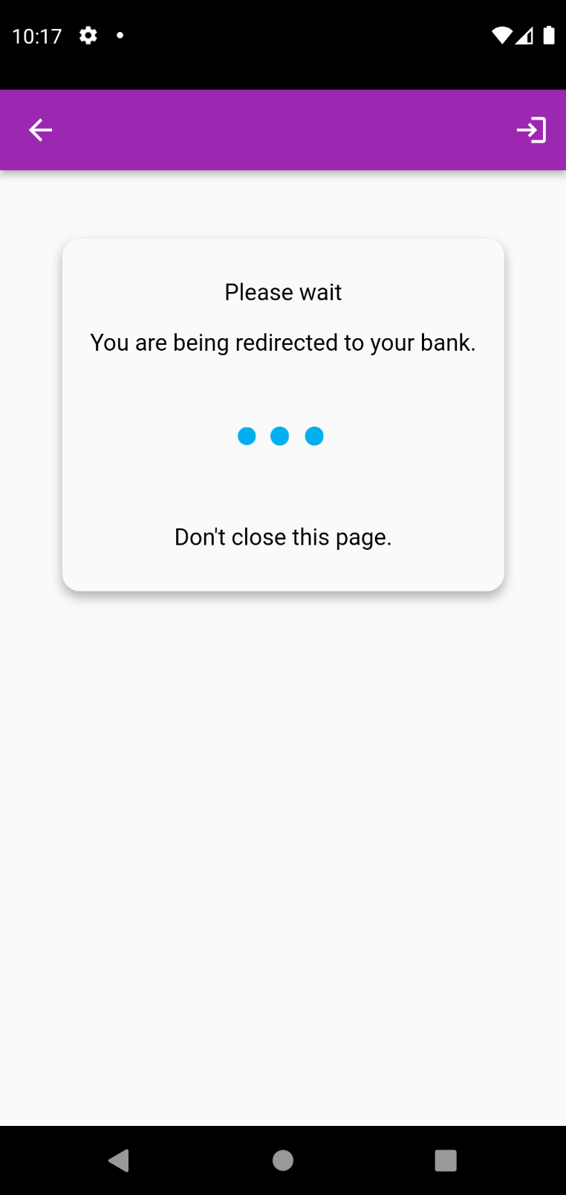
Payment integration (VISA)
Verification

Slide 53
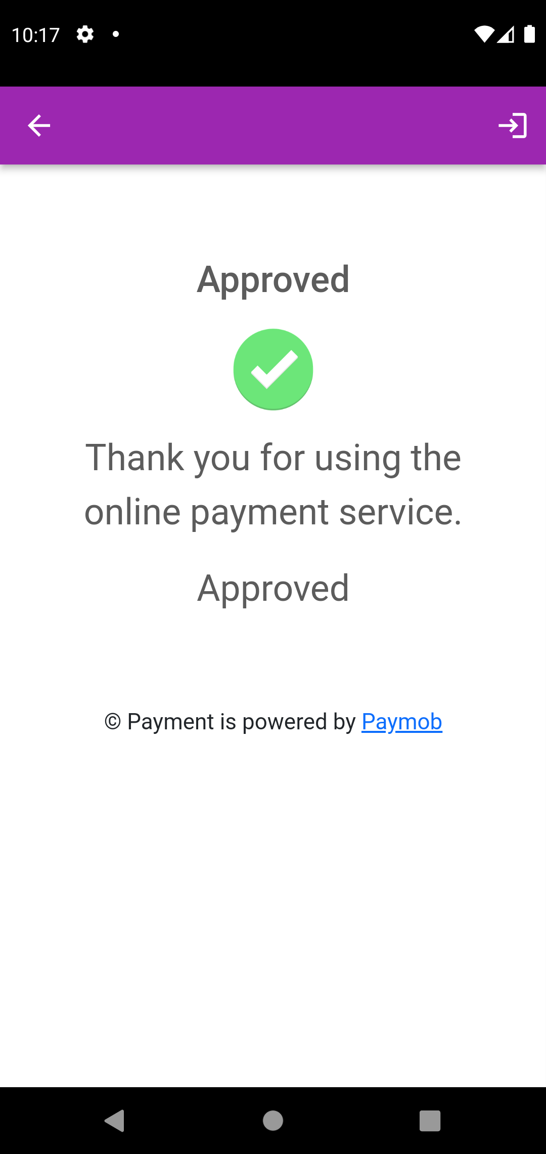
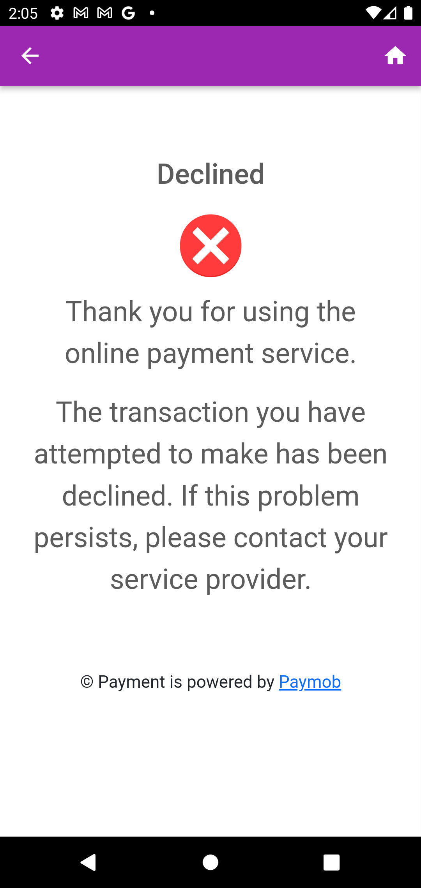
Approved
Declined

Slide 54
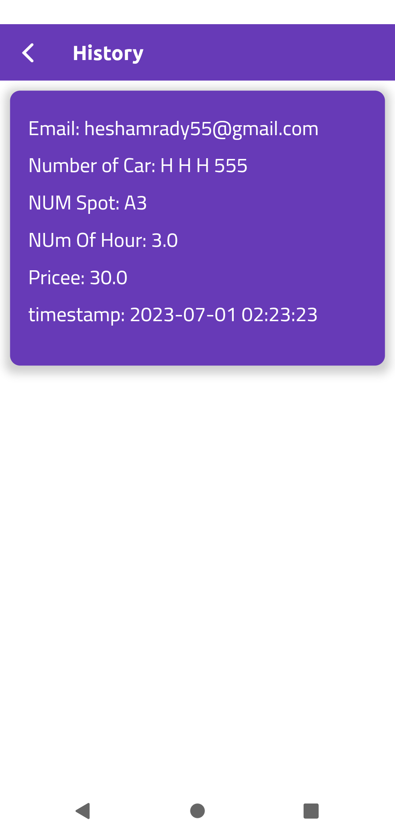
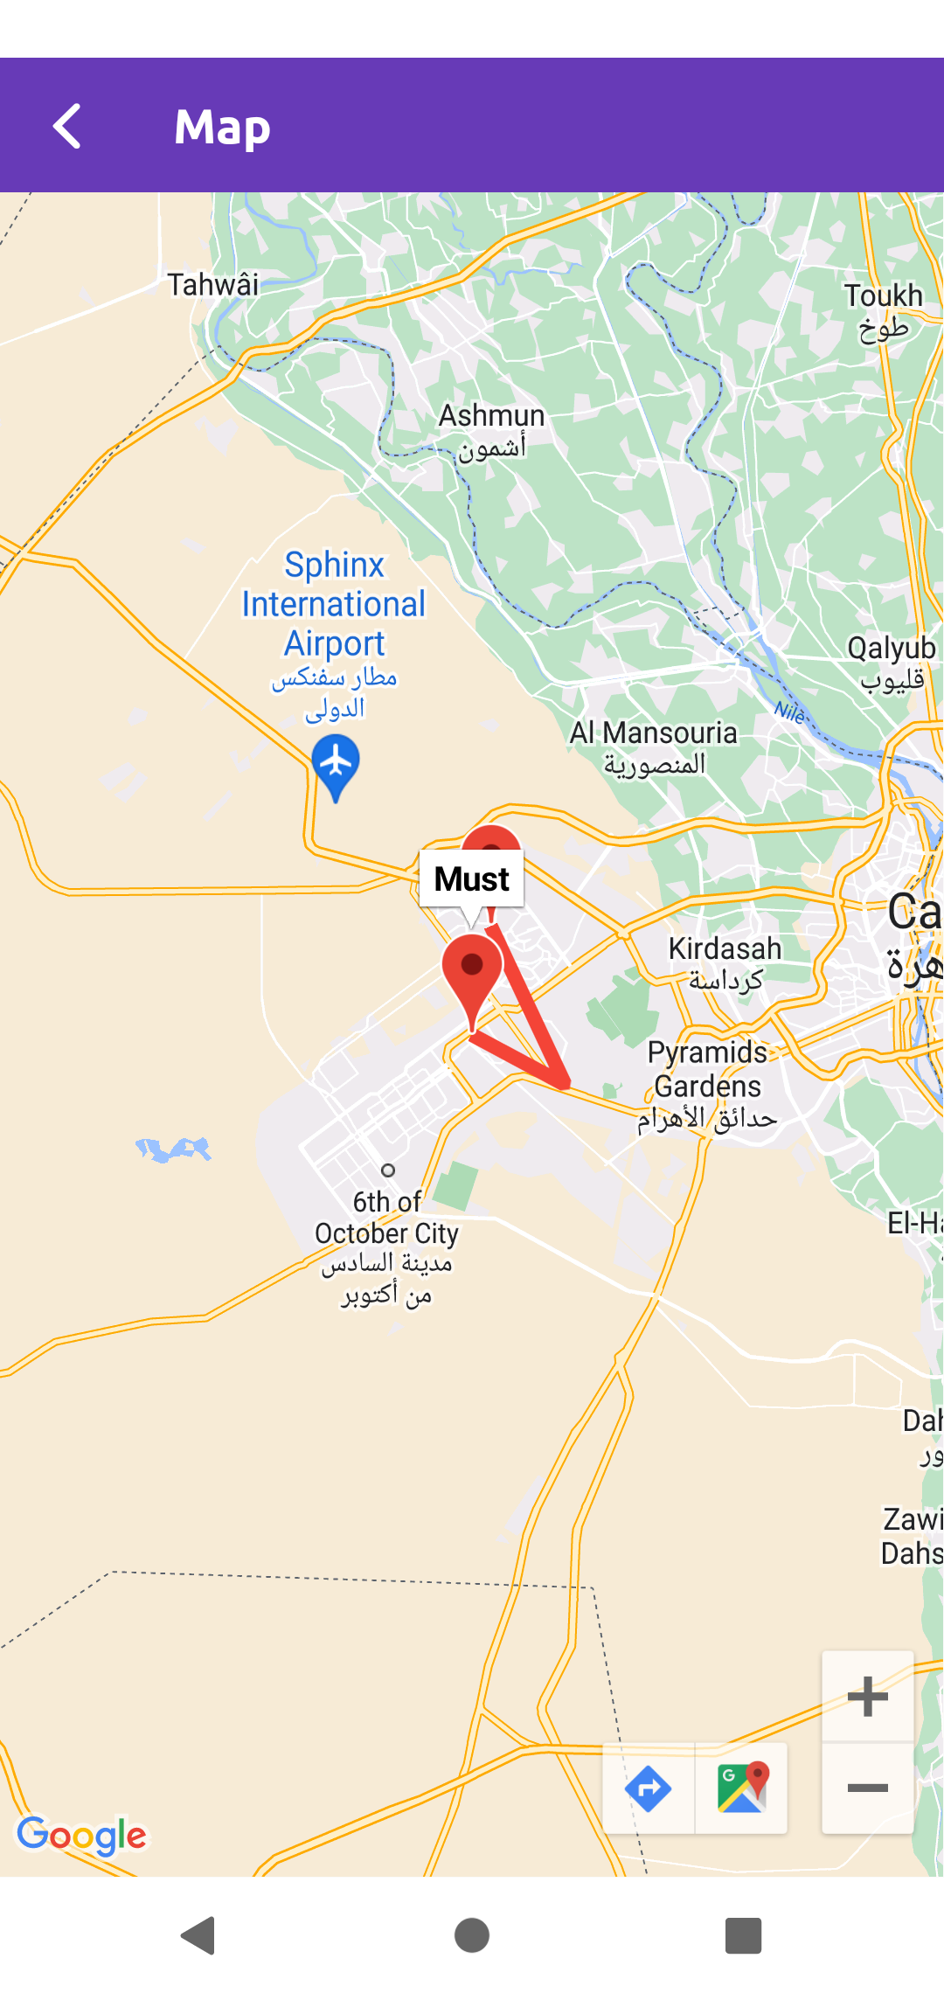
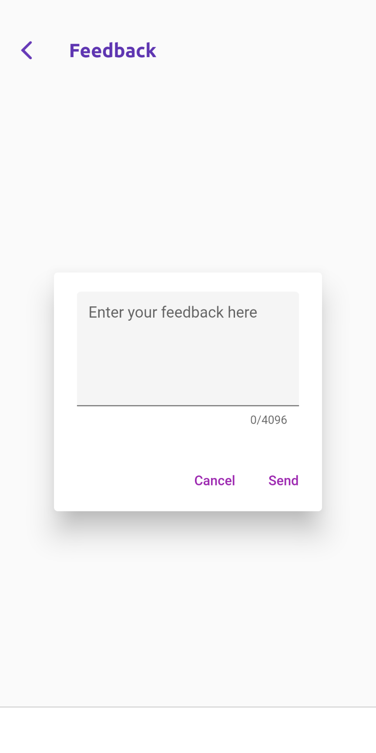
History
Feedback
Map

Slide 55
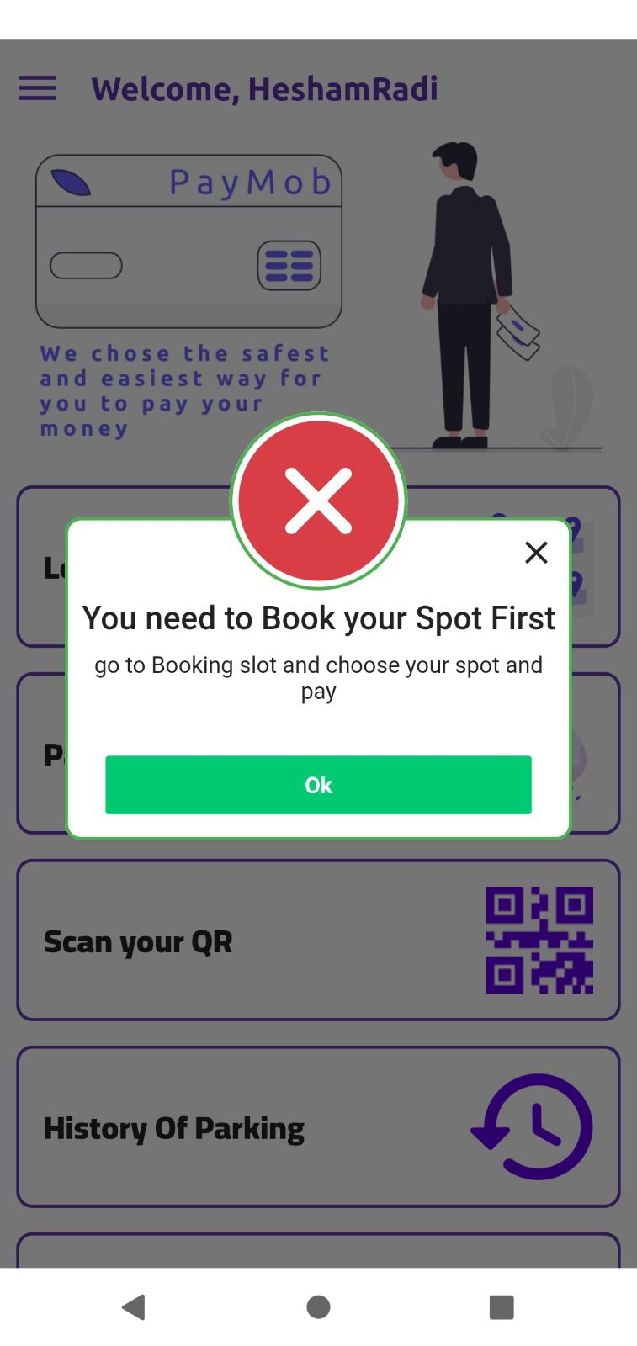
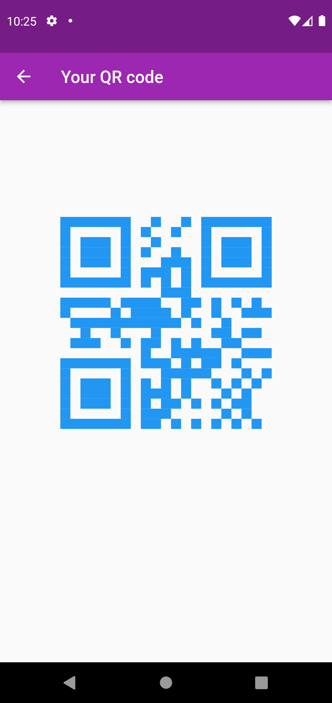
QR code

Slide 56

Demo videos
Login/Signup

Slide 57
Booking

Slide 58
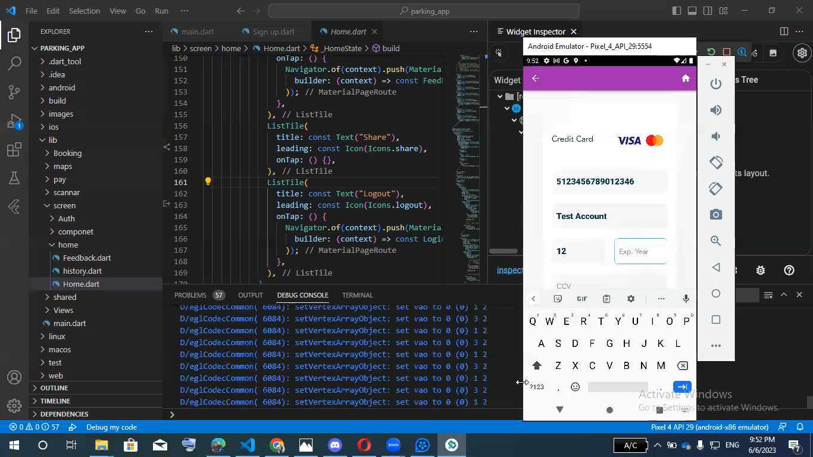
Payment

Slide 59
QR code/Map

Slide 60
15
System Validation

Slide 61
System Validation
1-Data collection: Gather data on parking spaces including details such as location, and availability status.
2-Data Accuracy: The system validates the accuracy of the parking data, including available parking spaces, pricing, and location information. This is done by regularly updating and verifying the data from reliable sources to ensure users are provided with accurate and up-to-date information.
3-Booking and Reservation Process: It involves testing the functionalities such as selecting a parking spot, making a reservation, and receiving confirmation. This validation ensures that users can easily reserve parking spaces without any issues. 4-Integration with Payment Systems: This involves testing the payment process to ensure users can make secure transactions for parking reservations using different payment methods as visa or fawry.

Slide 62
16
Time plan

Slide 63
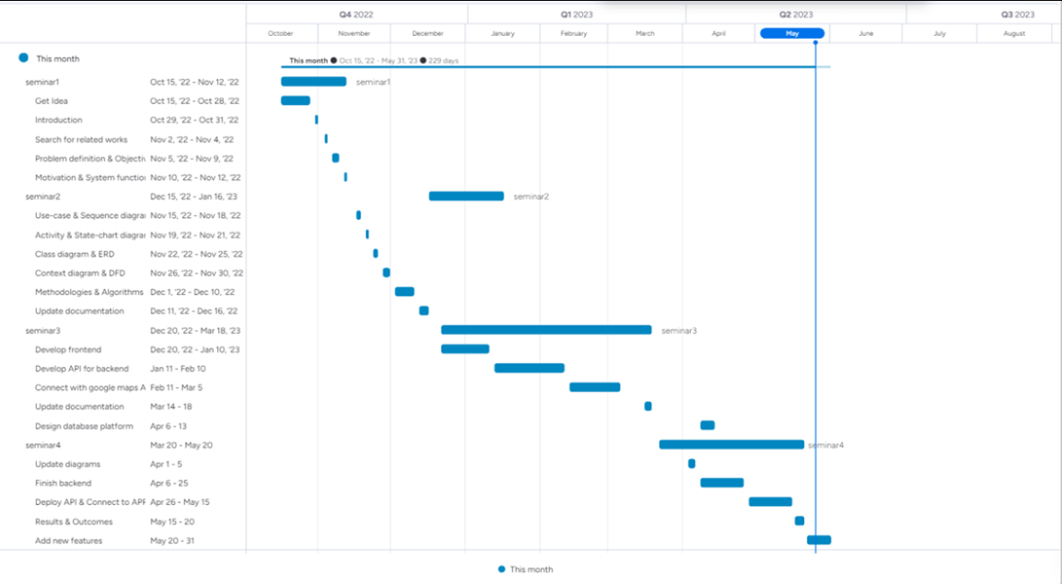

Slide 64
17
Conclusion

Slide 65
Conclusion
Our goal was to make an application that provides users an easy way of reserving a parking online where users can view various parking spaces and select nearby or specific area of their choice to view whether space is available or not. If the booking space is available, then user can book it for specific time slot. The booked space will be marked and will not be available for anyone else for the specified time. Users can also view previous parking booking details, it will saves user time and effort. At the end, we have come up with a program that made it easier for drivers to find suitable vacancies for them in terms of time and money.

Slide 66
18
References

Slide 67
References
L. Wenghong, X. Fanghua, and L.Fasheng, “Design of inner intelligent car parking system,” in International Conference on Information Man. 11. Gao, X., Gu, Z., Kayaalp, M., Pendarakis, D., & Wang, H. 2017. ContainerLeaks: Emerging security threats of information leakages in container clouds. In 2017 47th Annual IEEE/IFIP International Conference on Dependable Systems and Networks (DSN) (pp. 237- 248). IEEE
R.H Ellis et al. Structuring a systems analysis of parking. Highway Research Record (1970).
Barata, E., L. Cruz, and J.P. Ferreira. Parking at the UC Campus: Problems and Solutions. Cities, Vol. 28, No. 5, 2011, pp. 406–413.
Van der Goot, D. A Model to Describe the Choice of Parking Places. Transportation Research Part A: General, Vol. 16, No. 2, 1982, pp. 109–115.
Khattak, A., and J.W. Polak. Effect of Parking Information on Travelers’ Knowledge and Behaviour. Transportation, Vol. 20, No. 4, 1993, pp. 373–393.
Young, W. A Review of Parking-Lot Design Models. Transport Reviews, Vol. 8, No. 2, 1988, pp. 161–181.
Saltzman, R.M. Three Proposals for Improving Short-Term On-Street Parking. Socio-Economic Planning Sciences, Vol. 28, No. 2, 1994, pp. 85–100.

Slide 68


